Slide 1
ECOHYDROLOGY

Slide 2
Ecohydrology
Study of the effect ecology has on hydrology and vice versa
Ecologist
Might be more interested on the effects hydrology has on ecosystems/vegetation
Hydrologist/Climatologist
Initially more interested in how vegetation affects hydrology/climate
That leads to wanting to know the quantity and type of vegetation and how it got there (like an ecologist)
Hydroecology vs Ecohydrology
Some might suggest Hydroecology studies how ecology is affected by hydrology and Ecohydrology studies how hydrology is affected by ecology

Slide 3
Ecohydrology
Why study Ecohydrology??
Civil Engineering
Civilizations require water supply/flood control. How does vegetation affect this?
Ecology
Water is the lifeblood of ecosystems.
Climatology
Plant evapotranspiration cools earth’s surface and supplies water vapor to the atmosphere for producing rain

Slide 4
Interdisciplinary Field
Let’s explore this ecohydrological question: How do plants take water from the soil and release it into the atmosphere??
Here is a list of some disciplines/fields required to answer this question
Boundary Layer Meteorology
Radiative Transfer
Plant Physiology
Vegetation Dynamics
Soil Hydrology
Soil Ecology

Slide 5
Evapotranspiration
Evapotranspiration is the process in which plants release water vapor to atmosphere
This is abbreviated as ET from now on
As climatologist we are interested in ET
Evap/ET is driven by difference between vapor over water/plant vs. vapor in Atmos. combined with swirling wind

Slide 6
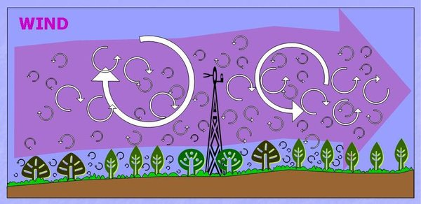
Turbulent Flux
Wind moving horizontally over uneven surface creates swirling eddies: Turbulence
Think of a paper bag flowing in the wind, it moves horizontally/vertically chaotically
When eddy swirls up it moves moist surface air away from ground

Slide 7
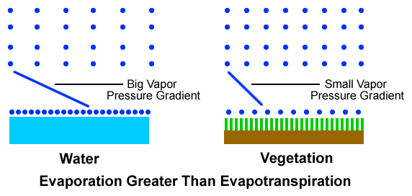
ET is typically much less than Evaporation of open water
Vapor pressure over water is saturated value and over plant it is less, WHY?

Slide 8
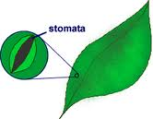
Stomata
Leaves have little pores on them called stomata which let in CO₂ for photosynthesis
But when this happens water vapor escapes, the “cost of doing business”
To save water plants close their stomata and ET=0. This happens at night (no sun!)
Cactus do the opposite, they let in CO₂ at night because RH is greater at night

Slide 9
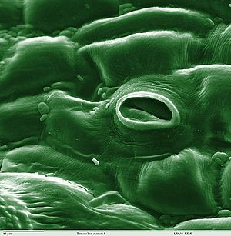
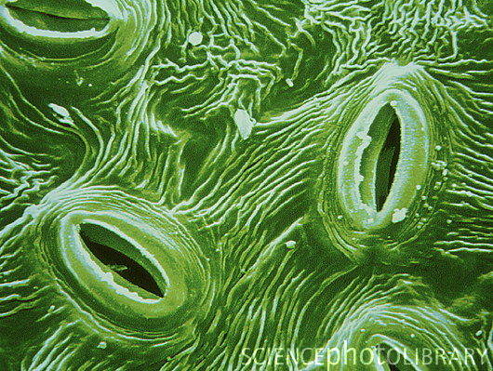
Stomata

Slide 10
Stomata/Soil Moisture
If lots of moisture is in soil, plants will leave stomata fully open
But, during dry periods, plants have evolved to adjust the amount that stomata are open in order to conserver water
If soil gets too dry, plant is unable to pull water from soil and will WILT and die.

Slide 11
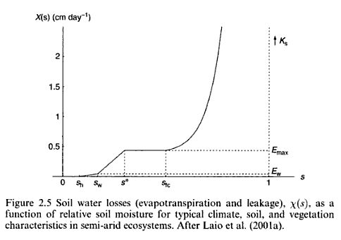
Daily Avg. ET vs. Soil Moisture
Actually graphs shows both ET and drainage losses.. Curved portion to right is drainage.

Slide 12
Stomatal Function
Last page described daily avg, but how does stomata function throughout the day?
Stomatal closure is a function of sunlight, temperature, humidity and Water In Leaf
Since leaf water depends on soil moisture, daily average ET depends on soil moisture
The next step is to understand how water flows from soil up to the leaf

Slide 13
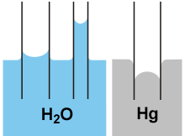
Water Potential
Think of water potential as pressure.
Usually water can only be compressed but in plants and soil it can be “pulled”
Pulling is negative Compression is positive
Surface tension/Capillarity leads to negative potential pulling water up tube

Slide 14
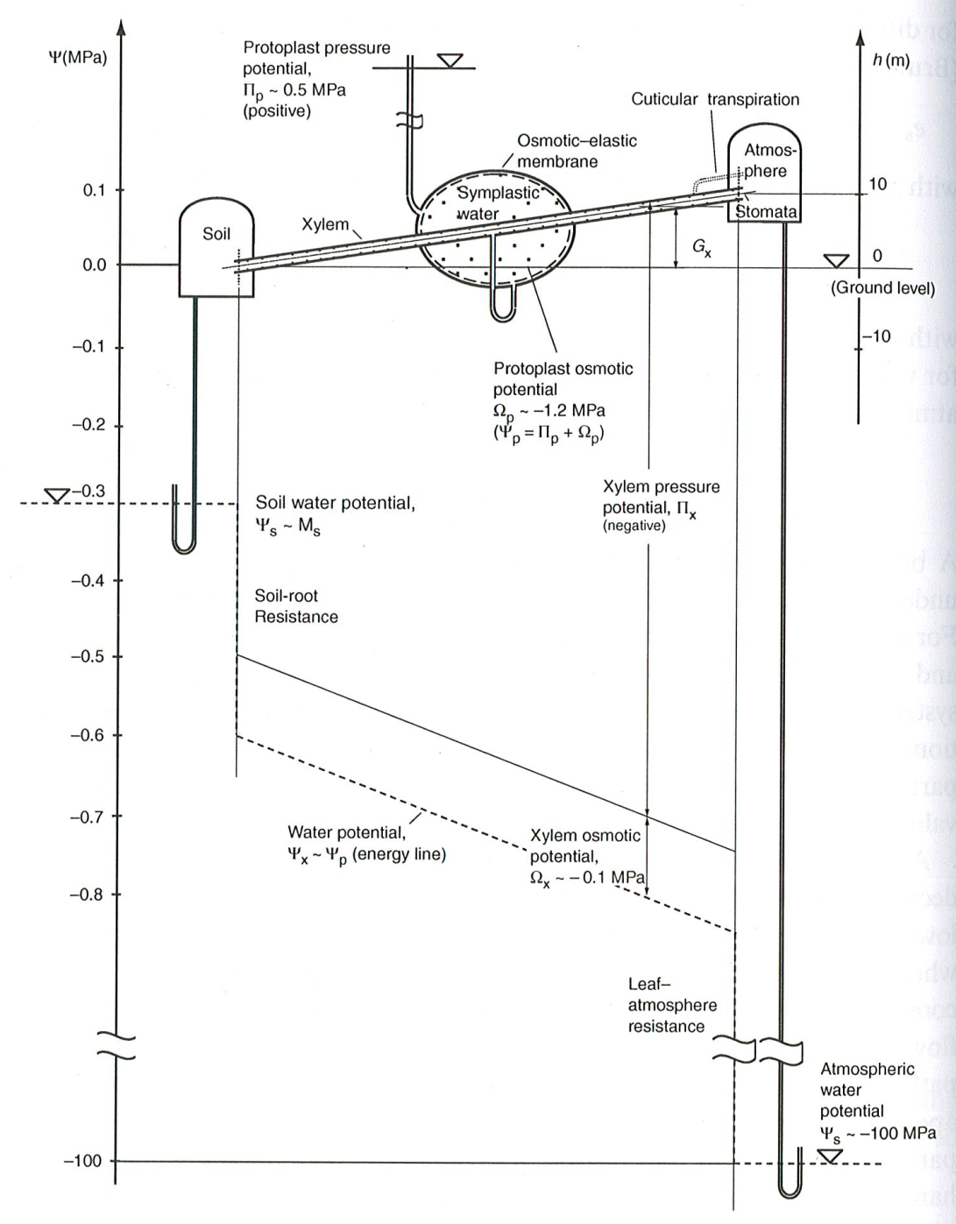
Water Movement
Water moves from soil to leaves
Leaves have more negative potential than soil
But how do leaves achieve such a large negative potential?

Slide 15
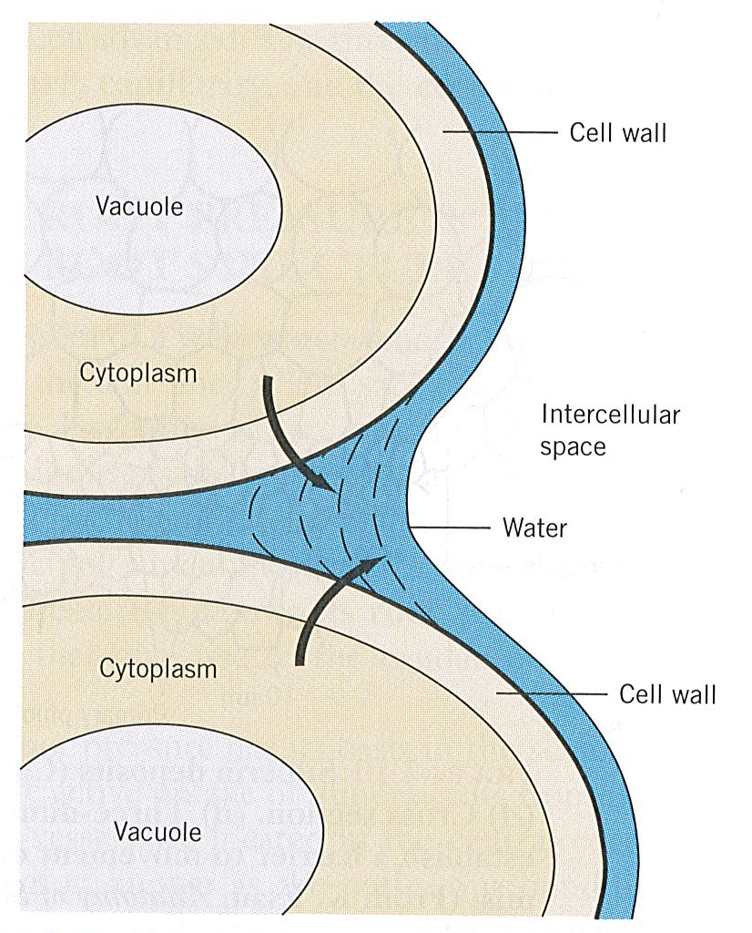
Cohesion Theory
Meniscus leads to negative pressure ie. tension/pulling
As water evaporates the meniscus radius decreases which increases tension/pulling ie. More negative pressure

Slide 16
Turgor Pressure
A leaf is crisp due to elastic walls holding it together like balloon
It is a positive pressure
The more water in leaf means more positive turgor pressure

Slide 17
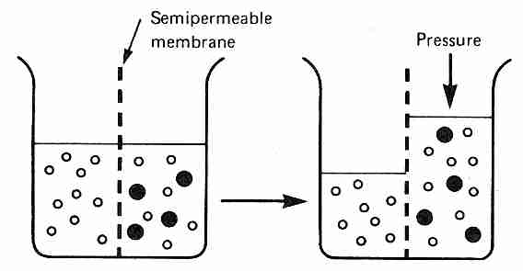
Osmosis
Osmosis is the movement of water between solution of different concentrations
Water will move from the more pure solution in an attempt to equilibrate solutions
Water in plant cells is less pure than outside, leading to negative potential ie. pulling

Slide 18
Osmosis and Turgor Pressure
Osmosis: As water moves into leaf, the solution in leaf gets more diluted reducing “pulling”
Turgor Pressure: As water moves into leaf it increase turgor or positive pressure/pushing which offsets the negative pressure/pulling due to osmosis
Moral of story: Due to osmosis leaf cells has net negative potential allowing flow from roots yet still has positive turgor for plant structure

Slide 19
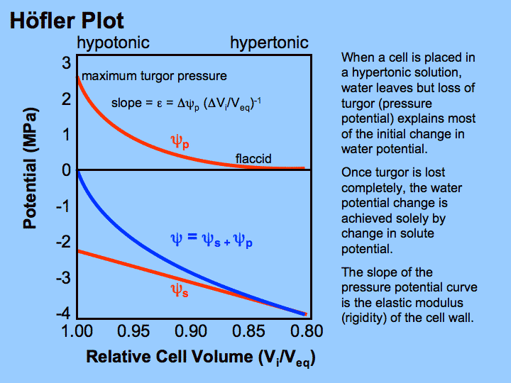

Slide 20
ET & Leaf Water
Amount of water flowing through plant equals amount flowing through atmosphere (ET)
When sun comes out it heats up plant and ET increases which decreases water in leaf
A decrease in leaf water 1) decreases turgor and 2) increases pulling (cohesion theory) until plant flow equals ET
If turgor pressure gets too low the plant WILTS
In order to survive, plants respond to tension by closing stomata decreasing ET and increasing Leaf Water which increases Turgor

Slide 21
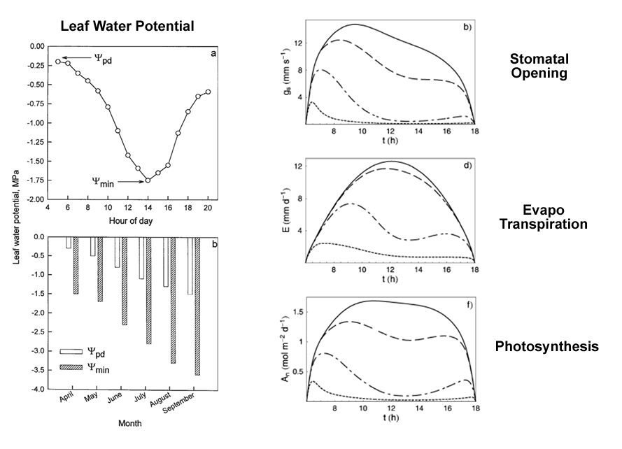
Daily Variation

Slide 22
More Water Use Components
Soil Texture: size of particles affect soil moisture. ie. Sand vs. Clay
Rooting Depth: depth of roots affects how plants respond to unpredictable nature of rain ie. Grass vs. Trees
POROSITY: Soil IS like a sponge. “Saturated” soil has water filling all the air space.

Slide 23
Drainage/Field Capacity
Surface tension of water means that some water remains in soil after draining. Surface tension “holds” some water (unsaturated)
Clay has smaller particles than sand thus it is more “sticky”, like a thin straw vs. wide tube.
Clay may hold 90% of saturation while Sand may hold 35% of saturation
This point is known as “Field Capacity”. The only other way to get water out of the soil is by evapotranspiration

Slide 24
Wilting Point
Doesn’t necessarily mean more water available for plants in clay because the same tension resisting gravity resists the plant from pulling out water
Thus the plant leaves behind more water in clay once it has wilted compared to sand
Clay may hold 60% of saturation while Sand may hold 10% of saturation at the wilting point

Slide 25
Soil Texture Effects
Effects sand vs clay has on plants is complicated interaction depending on climate, especially rainfall
In Colorado grassland, a dominant grass favored coarse soil (sand) in dry years and finer soil (clay) in wet years.
Could explain the dominance of this grass since in dry years AND wet years it always has somewhere to go because many soil types present. It doesn’t have to “start over”.

Slide 26
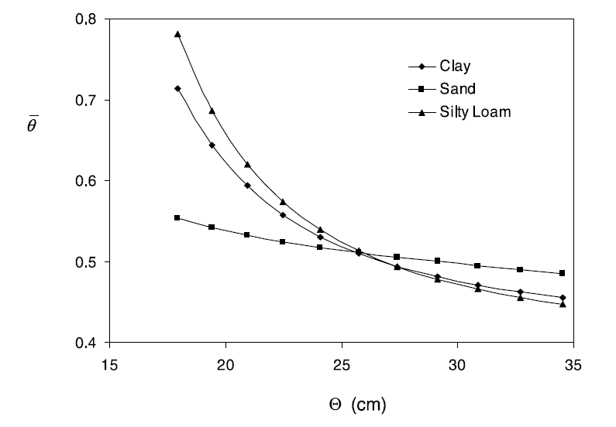
Water Stress vs. Rainfall
Colorado Grassland

Slide 27
Rooting Depth
Depth of roots is big factor governing plant response to random nature of climate/rainfall
Resistance: How long can the plant survive periods of low rainfall?
Resilience: How long does it take a stressed plant to bounce back once rainfall returns?
Trees have deep roots so they have more water available. Drought resistant.
Grasses have shallow roots so it takes less rain to fill root zone. Drought resilience.

Slide 28
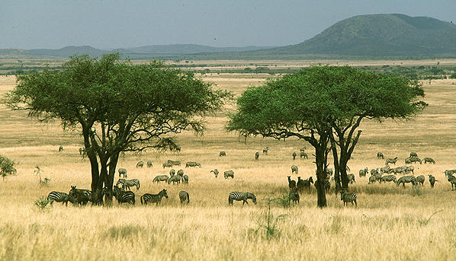
Savannas
Forests appear when annual rainfall is high
Grasslands appear when annual rainfall is low
In savannas, trees and grass coexist, WHY?

Slide 29
Savannas
The traditional explanation says they can coexist because the trees use the deep water while the grasses use the shallow water
S. Africa study suggests additional mechanism
The soil is shallow so both roots are shallow
The rain is such that grass is favored
It appears that tree roots move horizontally into grass areas and take water from grass
The tree/grass combo used water more efficiently than grass alone

Slide 30
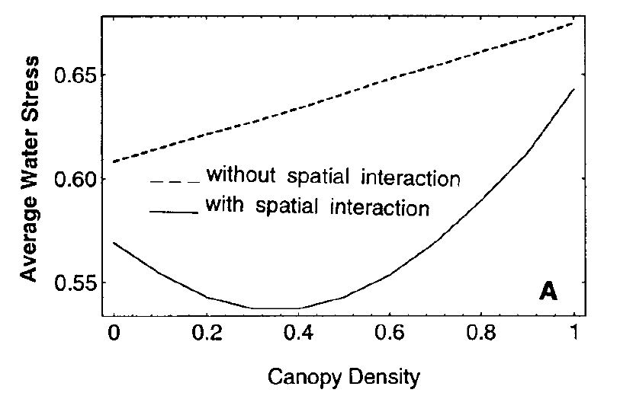
Water Stress vs. Tree Density
South Africa Savanna

Slide 31
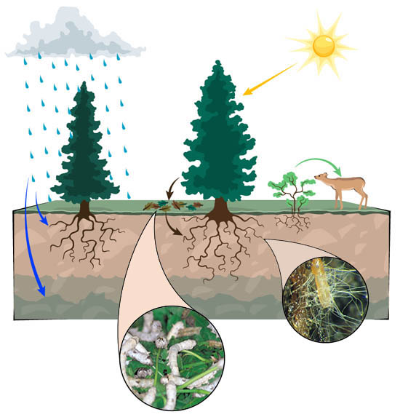
Soil Ecology
Soil is alive! Soil contains an ecosystem of bugs, worms, fungi, bacteria, etc forming a mutual relationship with plants
Soil life use leaf litter & dead roots breaking them down into the nutrients plants need

Slide 32
My Research
As we have learned evapotranspiration is important to Ecohydrology
Measuring Evapotranspiration directly with weather stations at surface limits coverage
My goal is to measure evapotranspiration using “Remote Sensing” ie. Satellite/Airplane
Basic idea is to measure surface temperature by measuring long wave radiation
Wet areas will be cooler and Dry areas will be hotter due to evaporative cooling

Slide 33
Only limited number of weather stations
Can not “interpolate” because lots of variation between points

Slide 34
Surface Temp.
Wetlands/Lake are COOL
Urban Areas/Fallow Fields are HOT
Ocean is exception. Evaporative Cooling is Offset by Energy Supplied by Warm Gulf Stream

Slide 35
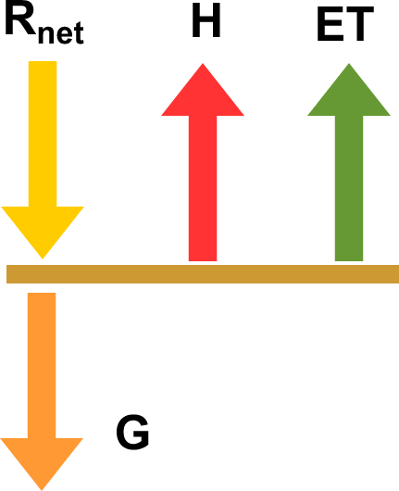
Energy Balance
Satellite measures: R_{net} =SW + LW
How is R_{net} divided between H and ET ?
Evaporative Fraction (EF) = ET/R_{net}
Get EF From Temp_{Surface}.
Coldest area has max EF.
Hottest area has min EF

Slide 36
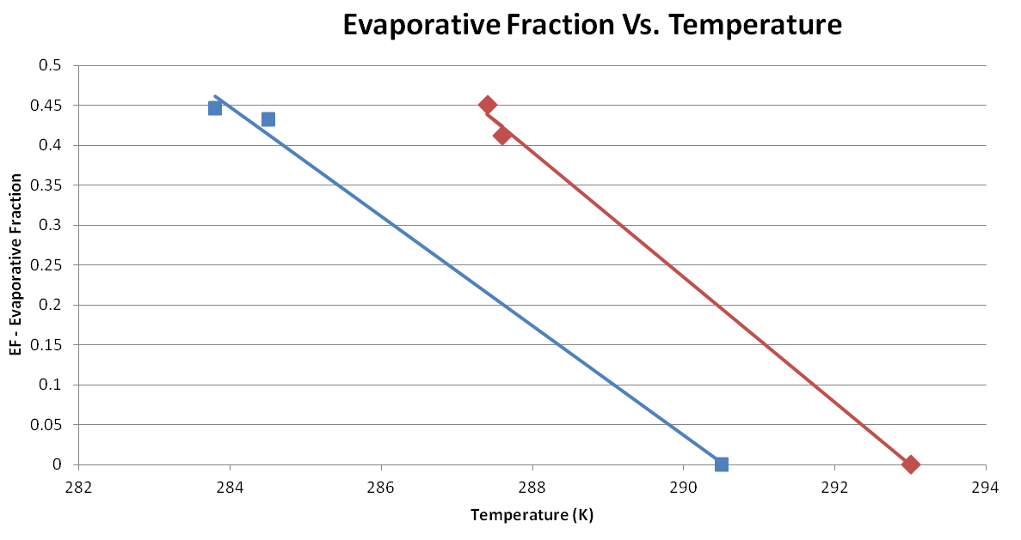
Use surface weather station to get dependence of EF on Temperature
Weather station only applies to region surrounding it where atmosphere similar

Slide 37
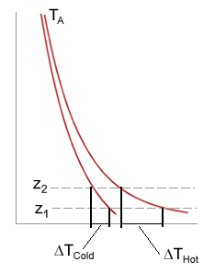
Air Temp in Boundary Layer
Air near surface will vary due to wetness of surface but air away from the surface can be similar since atmosphere has smoother variation than the surface

Slide 38
Nigh Night

